Slide 1

Airline Recommendation System
Group 3:
Srija Bandlamudi
Roshna Sanjana Kommareddy
Kashmeera AkkenapaLLY
Rishika Annu
Mounika Kasaragadda

Slide 2
Agenda
Abstract
Introduction
Problem statement
Objectives
Literature survey
Functional REQUIREMENTS
System Requirements
Implementation
UML DIAGRAMS
OUTPUT SCREENS
References

Slide 3

Abstract
This research focuses on how customers are relying more and more on online resources to make their purchase decisions, how companies utilize customer reviews to understand their priorities, and how their decisions affect reviews. A predictive analysis of data collected from websites was applied for qualitative assessments, and a descriptive study of airline service classifications was carried out. The findings reveal that most of the business class travelers place a high value on the cuisine and friendliness of the staff, while those traveling in economy class place a higher value on legroom and seat comfort. The study emphasizes how crucial it is for firms to comprehend consumer preferences in order to enhance their product offerings and increase satisfaction with customers.

Slide 4
Introduction
Online reviews continuously project a positive image of a product or service to potential customers and build brand recognition, which is advantageous to businesses both now and in the future. According to Pew Research Center, 82% of American adults indicated they read online customer reviews or ratings before making a first-time purchase of any goods.
Due to the abundance of options between the same routes in the airline industry, the availability of online reviews has allowed various businesses to investigate those reviews to better understand consumer reactions and identify areas where they need to improve in this cutting-edge competitive environment. Review data are unstructured, often containing anomalies and ambiguities, and are present in such vast quantities that manual analysis of them is highly challenging. In order to study the data and get insights, we used machine learning techniques in this project. By using stemming, normalization, and n-gram data calculations, we applied natural language processing to the review. To determine if a user will suggest it or not using various models, we used predictive analysis.

Slide 5
Problem Statement
Online ratings have developed into a key source of information for businesses to understand customer reactions and suggest areas for development in the fiercely competitive airline market where there are multiple alternatives for the same routes. Manual analysis is challenging with data from reviews since it is unstructured and frequently has abnormalities and ambiguities.
Additionally, organizations find it difficult to filter and extract useful insights from large amounts of data. In order to better understand customer preferences and raise customer happiness, the airline industry has to create effective ways for evaluating online review data.

Slide 6
Objectives
Convolutional Neural Networks and Random Forests will be used in the prediction process to create a deep learning and machine learning-based recommendation system for airlines that will be based on customer evaluations and ratings. To offer clients results that are easy to use when choosing a source and destination based on the system's suggestions.
During the system's creation and implementation, it is important to taken into account social factors that are closely associated with the recommendation system, such as user preferences and satisfaction to assess the Random Forest method's performance in making predictions for the recommendation system by giving companies information on consumer preferences and areas for development based on a study of customer evaluations and ratings, to contribute to the development of the aviation sector.

Slide 7
Literature Survey
Predicting flight delays accurately is essential for enhancing the effectiveness of the airline sector. This project intends to build models that can anticipate delays for a wider range of circumstances, whereas prior research has concentrated on using machine learning to estimate delays for certain routes or airports.
In order to build a complete dataset, the study gathers and pre-processes Automatic Dependent Surveillance-Broadcast (ADS-B) signals. It then integrates these messages with additional data, such as weather information, flight schedules, and airport details. To forecast flight delays, the study uses both classification and regression techniques. Long Short-Term Memory (LSTM) can handle the aircraft sequence data well, according to experimental results, however, overfitting difficulties may arise with a short dataset. The study suggests a random forest-based model with improved prediction accuracy.

Slide 8
The aim of this project is to create a model that properly predicts aircraft delays brought on by bad weather using data mining and supervised machine learning approaches. To lessen the effects of unbalanced training data, sampling approaches were utilized in conjunction with domestic US flight data and meteorological data from 2005 to 2015. AdaBoost, k-Nearest-Neighbors, decision trees, and random forests were just a few of the machine-learning techniques used to build special models for predicting flight delays.
To assess the models' performance, the ROC curve and prediction accuracy were compared. The model, which can perform binary classification to determine if a planned aircraft will depart on time, integrates both weather forecasts and flight data throughout the prediction phase. In this study, we examine customer- and airline-side prediction models. Our evaluation research shows that models on both sides rely on a select few factors, including past data on ticket pricing, the day that tickets were purchased, and the departure date.

Slide 9
Functional Requirements
Functional Requirements: The proposed application ought to be capable of classifying and rating given by the users for recommending best airline suggestions for the users.
Data preprocessing: Preprocessing is done to transform unprocessed data into a format that can be used by machine learning. A data analyst can use an Applied Machine Learning algorithm to obtain results that are more precise by using structured and clean data. The method entails resizing images, changing colors, organizing data, cleansing, and the sampling process.
Dataset splitting: Training, test, and validation groups should be divided into three categories when using a dataset for machine learning.
Training set: To train a machine learning model and specify the best parameters that it should learn from data, a data scientist employs a training collection.

Slide 10
Test set: For an assessment of the learned model's (trained model) generalizability, a test set is required. The latter refers to a model's capacity to find trends in current, unexplored data after being taught on training data. Using various groups for training and testing is essential to preventing model overfitting, which causes the lack of generalizability we discussed above.
Model training: A data scientist can start building a model after preprocessing the gathered data and separating it into train and test sets. This procedure involves "feeding" training data to the program. Predictive analysis uses a program to process data and produce a model that can locate a goal value (attribute) in recent data. Developing a model is the purpose of model training.

Slide 11
Model evaluation and testing: This step's objective is to create the most basic model that can accurately and quickly construct a target value. Through model tuning, a data analyst can accomplish this objective. To attain an algorithm's best efficiency, model parameters are optimized in this manner.
Functionality: The application is developed in such a way that any future enhancement can be easily implementable. The project was created in a manner that needs minimal maintenance. The programs used are simple to setup and open source.
Reliability: It is the maturity, fault tolerance and recoverability. The system is reliable for any number of user input and training dataset.
Usability: It is easy to understand, learn and operate the software system. User can give source and destination as input to get the recommended airlines predicted by the algorithm.

Slide 12
System Requirements
CPU: Intel Core i5 or equivalent
RAM: 4 GB or more
Storage: 100 MB free disk space
Internet connection required for initial setup and updates.
Processor: Any processor above 500 MHz.
Hard Disk: 4 GB of free space or higher.
Input Device: Standard keyboard and mouse.
Output Device: VGA and high-resolution monitor.
Programming Language: Python 3.6 or higher.
Libraries: pandas, flask, matplotlib, Keras, Tensorflow, and any other dependencies required by the specific application.

Slide 13
Implementation
The modules included in our implementation are as follows
Dataset collection
Review based airline prediction
Rating based airline prediction
Predict airline based on source and destination

Slide 14
Algorithm Used:
Random forest and Convolutional Neural Network
Random Forest Model
1. Assuming the training dataset has n cases. Sub-samples are selected at random with replacement from these n examples. The individual trees are constructed using these arbitrary sub-samples taken from the training dataset.
2. With the assumption that there are k input variables, a number m is selected such that m k. At each node, m variables are chosen at random from a pool of k variables. The best split among these m variables is selected to split the node. While the forest expands, the value of m remains constant.
3. Each tree is allowed to grow as big as it can without being pruned.
4. The class of the new item is projected using the total votes cast by all voters.4. Based on the results of the combination of all the decision trees, the class of the new object is projected.

Slide 15
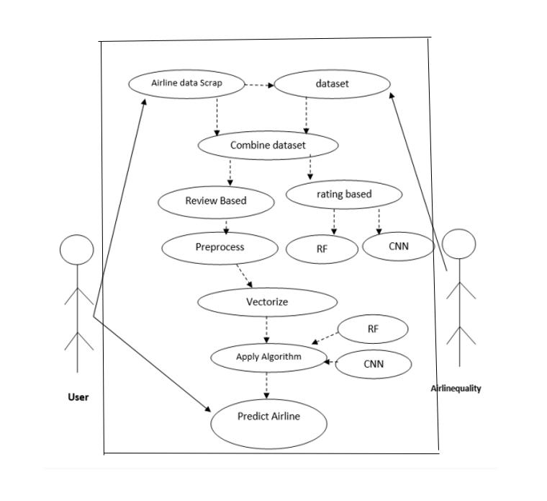
UML Diagrams
USE CASE DIAGRAM

Slide 16
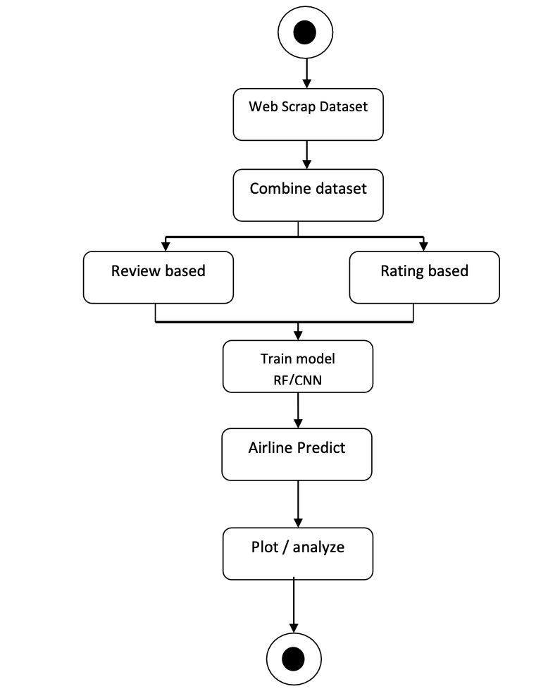
ACTIVITY DIAGRAM

Slide 17
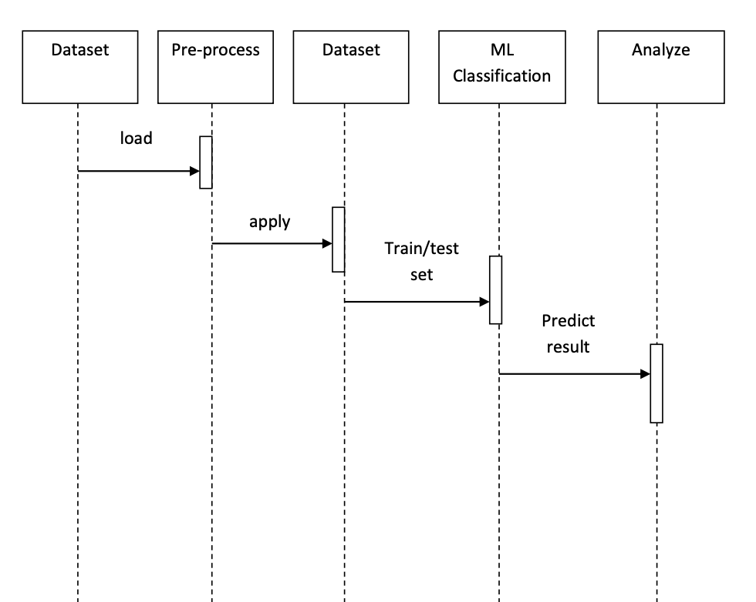
SEQUENCE DIAGRAM

Slide 18
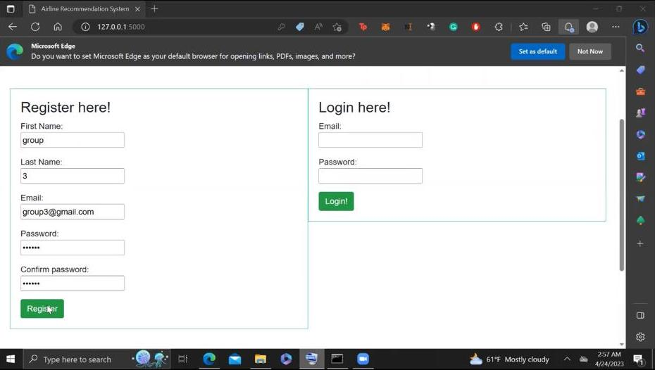
OUTPUT SCREENS

Slide 19
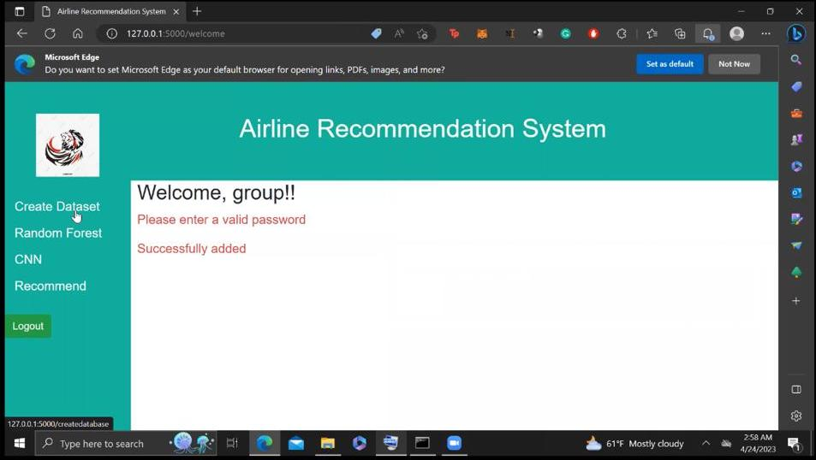

Slide 20
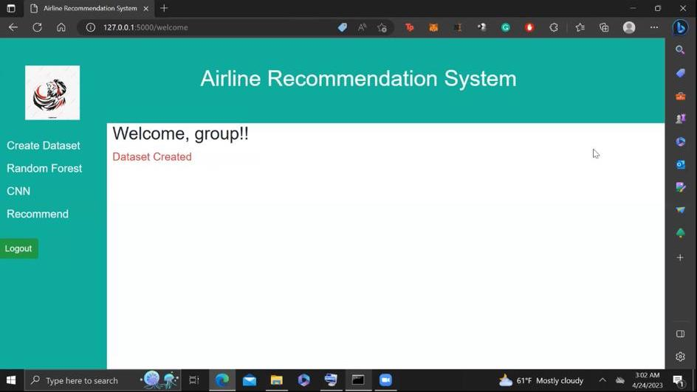

Slide 21
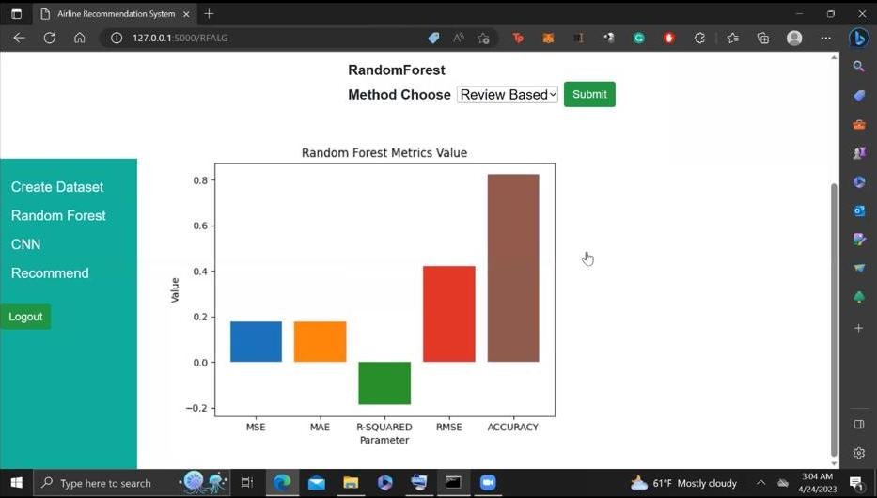

Slide 22
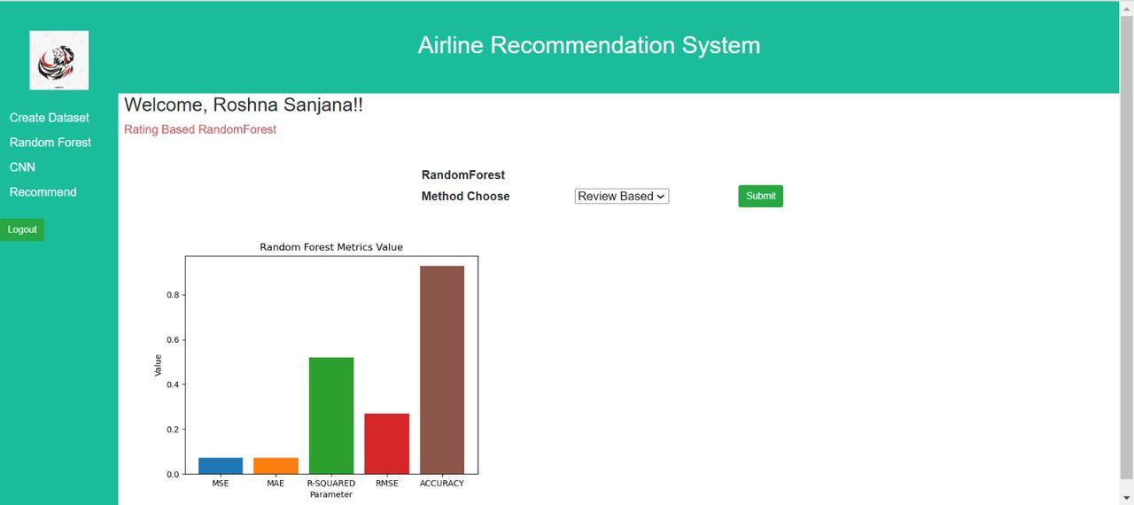

Slide 23
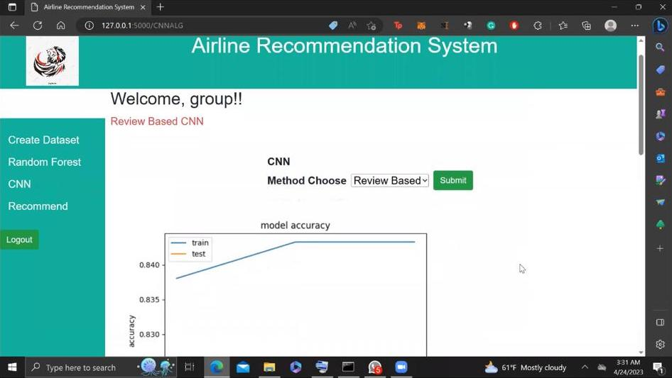

Slide 24
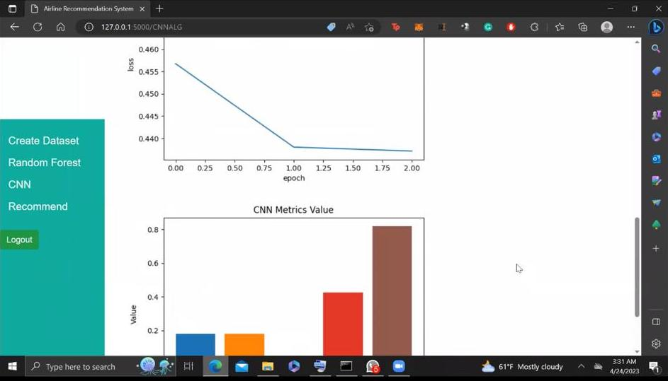

Slide 25
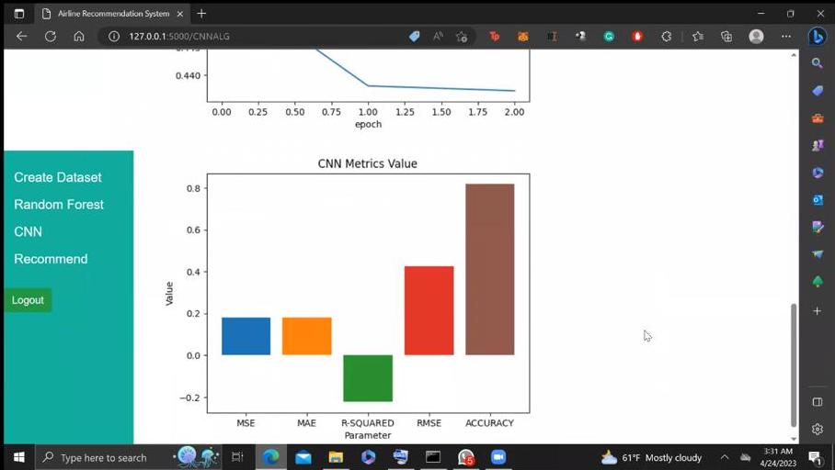

Slide 26
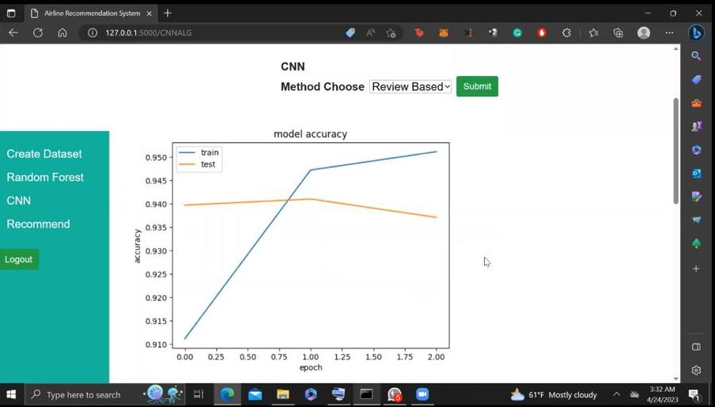

Slide 27
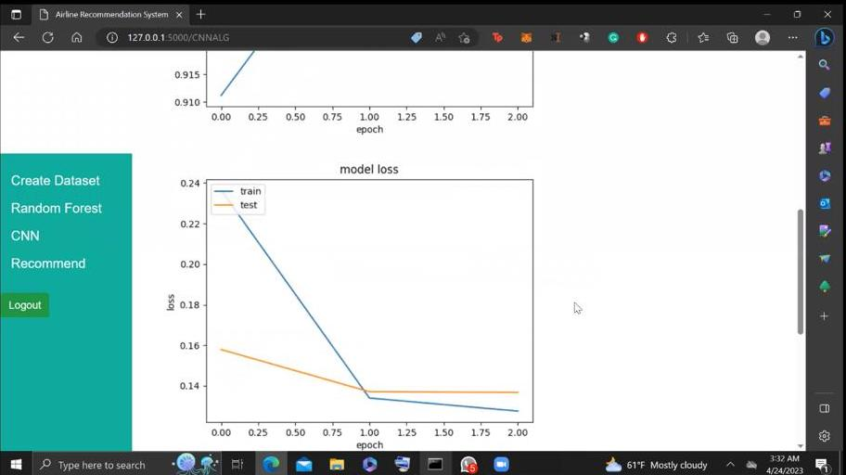

Slide 28
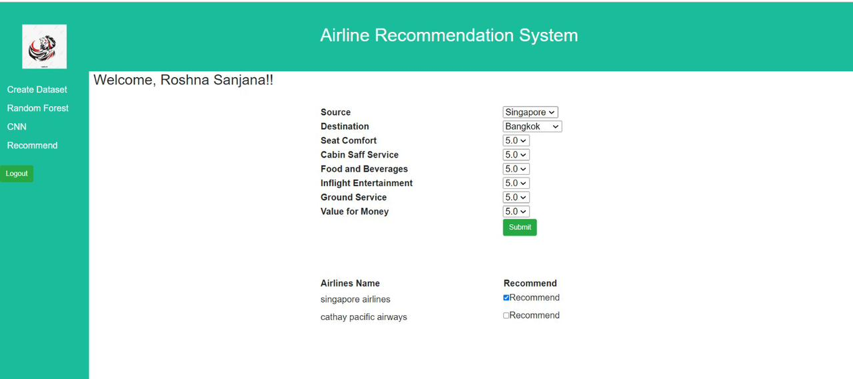
FINAL OUTPUT SCREEN

Slide 29
References
Flight Delay Prediction Using Machine Learning and Big Data in Aviation, IEEE Transactions on Vehicular Technology, vol. 69, no. 1, pp. 140–150, Jan. 2020; doi: 10.1109/TVT.2019.2954094; G. Gui, F. Liu, J. Sun, J. Yang, Z. Zhou, and D. Zhao.
Using machine learning methods, predict flight delays caused by the weather 2016 IEEE/AIAA 35th Digital Avionics Systems Conference (DASC), pp. 1-6, doi: 10.1109/DASC.2016.7777956, S. Choi, Y. J. Kim, S. Briceno, and D. Mavris.
A New Method: Machine Learning-Based Prediction of Airline Delays, 2018 International Conference on Computational Science and Computational Intelligence (CSCI), pp. 1081–1086. V. Natarajan, S. Meenakshi Sundaram, G. Balasubramanian, and S. Sinha.
Machine learning for cost-sensitive airline delay prediction, 2017 IEEE/AIAA 36th Digital Avionics Systems Conference (DASC), S. Choi, Y. J. Kim, S. Briceno, and D. Mavris, pp. 1–8, doi: 10.1109/DASC.2017.8102035.

Slide 30


